Slide 1
Intrusion detection in computer network
March 4nd 2018

Slide 2
KDDCup99 challenge
Detecting network intrusion prevents unauthorized users from accessing computer network
The learning task:
Build a classifier to differentiate normal connections from abnormal ones
Build a multi-classifier to classify attacks to different types

Slide 3
Agenda
Attack types, features and datasets
Data preprocessing
Models, parameter study and the implementation details
Logistic regression(Supervised learning)
Decision tree(supervised learning)
Kmeans(unsupervised learning)
Comparison of models
Summary

Slide 4
Four different types of attack
DOS: deny of service, e.g back,neptune, pod, land, teardrop, smurf
R2L: unauthorized access from a remote machine,
e.g ftp_write, guess_passwd, multihop, perl,phf, spy,
warezclient, warezmaster
U2R: unauthorized access to local super user privileges, e.g. buffer_overflow, loadmodule, rootkit
Probe: surveillance and other probing.
e.g Ipsweep, portsweep , nmap, satan

Slide 5
Features
A total of 41 features
Basic: 9 features, attributes of individual TCP connection
e.g. duration, protocol type, flag, wrong fragments, urgent
Content:13 features, attributes within a connection suggested by a domain expert
E.g. num_failed_logins, num_root
Traffic: 19 features, attributes computed using a two-second time window
E.g. count, serror_rate, rerror_rate

Slide 6
Dataset Statistics
Dataset | size
training data | 4,898,431
10 percent training data | 494,020
Test data | 311,029
Distribution of Attack type in 10% training data
71% are abnormal with two main DOS attack types:
Neptune and smurf

Slide 7
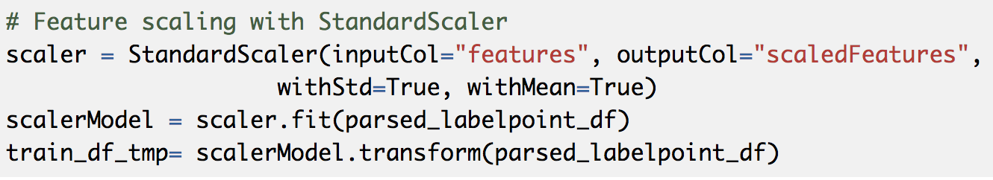
Data preprocessing
Using full training dataset is time consuming
Use 10 percent of sampled training data to reduce the training time
As long as learned models do not overfit the train data, using full data does not help much
I have tried full dataset which shows that running logistic regression on 10 percent data achieves almost the same f1 score
The training and test datasets contains duplicates
It is important to respect the distribution of attack types
It is interesting to compare f1 of orginal data VS the version after removing duplicates (future work)
The numerical fields are not at the same scale
Feature scaling for Kmeans and logistic regression

Slide 8
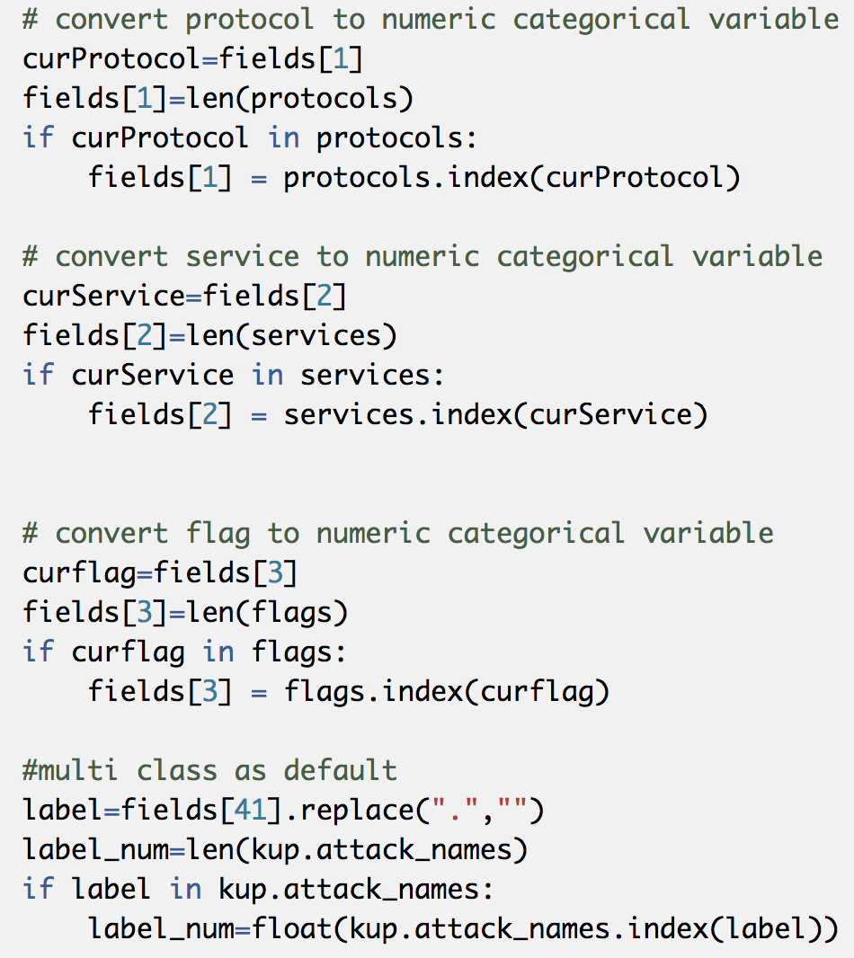
Handling categorical values
Labels are type of string denoting different attack types. It needs to transform to numerical values
There are 3 features that are categorical values including protocol, service and flag
For both label and features, generate an array of the unique values and use the index as the numerical values

Slide 9
Models
Supervised learning
Logistic regression
Short training ant test time, efficient and powerful learning algorithm
Decision tree
Easy to understand
Unsupervised learning
Kmeans
It helps to detect unknow types
Compare different models in terms of accuracy, f1 score and training, predicting runtime
Evaluation metric
Accuracy
Precision, recall, f1
Training time and predicting time
Experimental setup
Single machine, 16 G memory, 2.7 GHz Intel Core i7, macOS sierra 10.12.6
Spark 2.1.1; python3

Slide 10
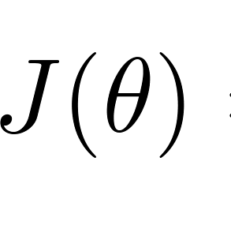

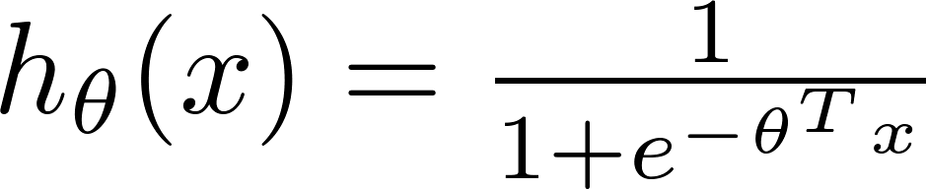

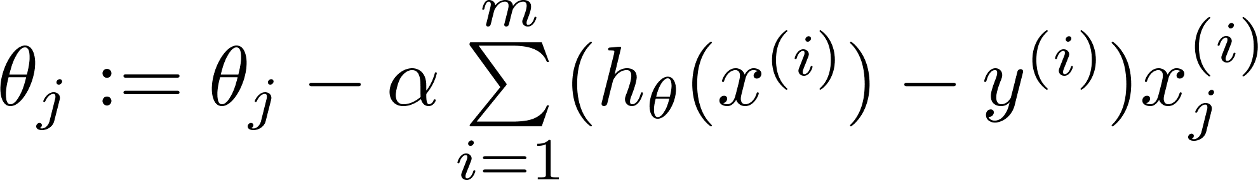


Logistic Regression
Cost function
Gradient Descent
Repeat
Regularization is used to prevent overfitting

Slide 11
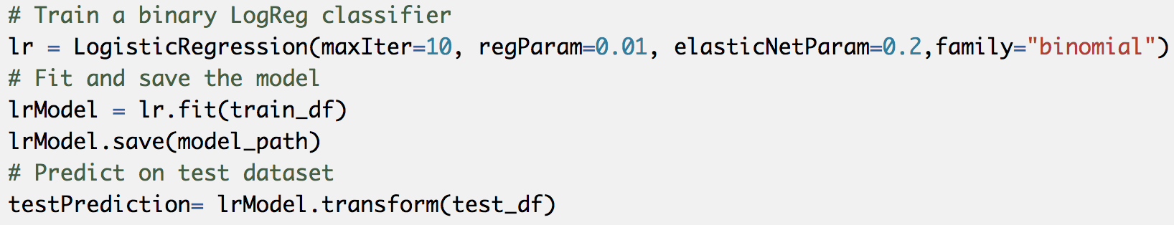
Implementation of binary logistic regression classifier
Binary classification is used to detect abnormal connection from normal ones
Regularization parameter can be tuned to improve f1

Slide 12
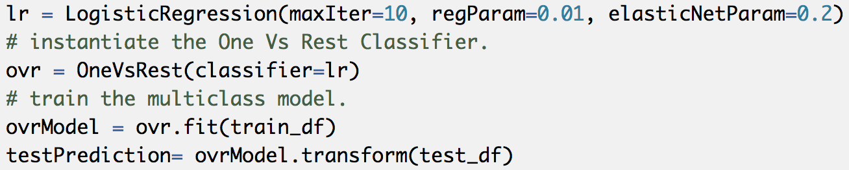
Implementation of multiclass logistic regression classifier
One VS All method is used to learn a multi-classification classifier

Slide 13
Impact of regularization parameter
It demonstrates the trade off between precision and recall. When regularization parameter is small,
It overfits the data and achieves lower recall. When the regularization parameter is large, it underfits the data,
and drop down precision significantly. Regularization =0.01 achieves the best performance.

Slide 14
Decision Tree
Decision tree uses tree-like model of decisions
It visually represents decisions
It does not transform features and is easy to explain
It uses a recursive binary splitting to greedily choose the best split based on cost
Gini index: a measure of purity, total variance across K classes
Entropy: a small value indicate the node is pure
Use pruning to trade off the subtree complexity and the fitting to training data

Slide 15
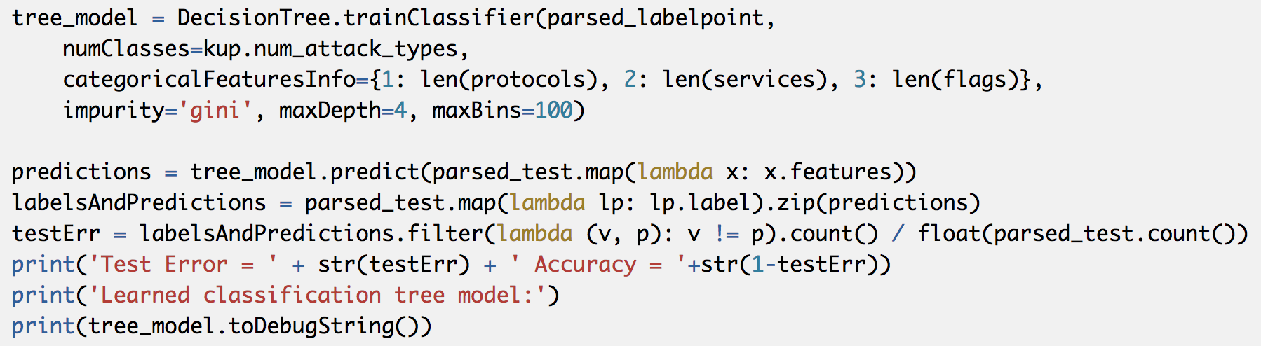
Implementation of Decision tree
Depth, bins size and minInstancesPerNode can be tuned for exploring the impact on accuracy of learned classifier.

Slide 16
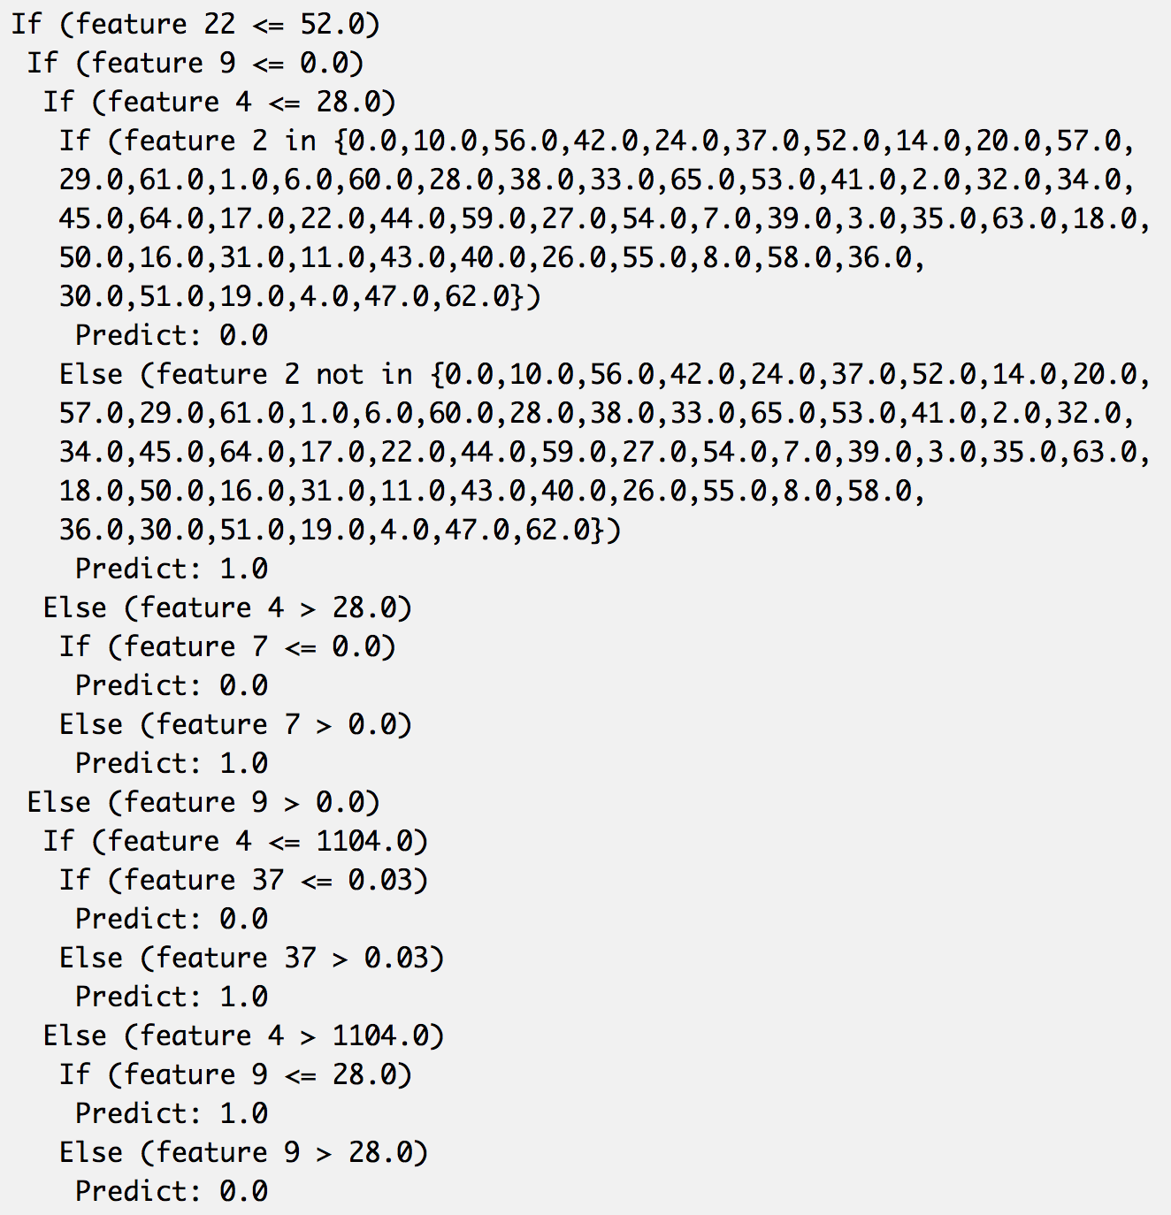
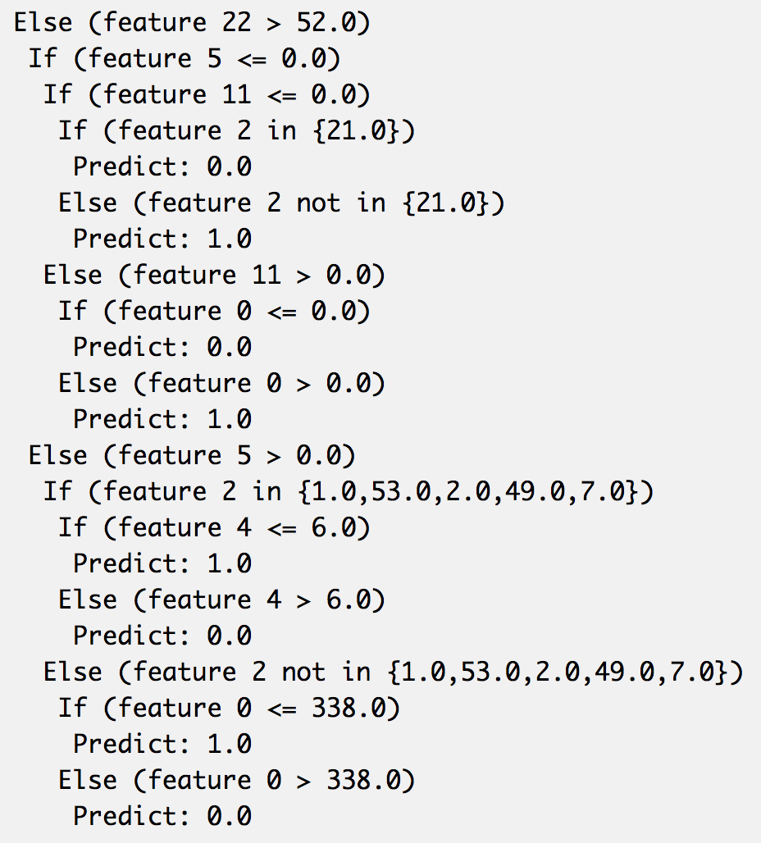
Learned tree

Slide 17
Analysis of learned tree
Feature 22,: number of connections to the same host as the current connection in the past two seconds
Most normal users have few number of connections
Feature 5, land: 1 if connection is from/to the same host/port; 0 otherwise
Most user land from the same host and to the same port
Feature 11, logged_in:1 if successfully logged in; 0 otherwise
Most user can logged in successfully
Feature 2,service:network service on the destination, e.g., http, telnet, etc.
Not a urp_i
Feature 9, hot:number of ``hot'' indicators
Feature 4,src_byte:number of data bytes from source to destination
Interesting to learn that hot indicators between 0-28 and src_byte >1104 can potentially be attack.

Slide 18
Impact of depth of tree
Increasing the tree depth helps slightly improve recall. It flattens out when tree depth is greater than 12.
Increasing the tree depth also increase the training time and the complexity of the tree.

Slide 19

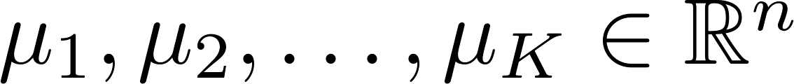


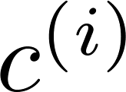
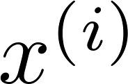

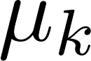
Kmeans
A unsupervised clustering algorithm aiming to identify natural groups of data
It can be used to detect the anomalies that are not seen before
Algorithm
Randomly initialize cluster centroids
Repeat {
for = 1 to
:= index (from 1 to ) of cluster centroid
closest to
for = 1 to
:= average (mean) of points assigned to cluster }

Slide 20
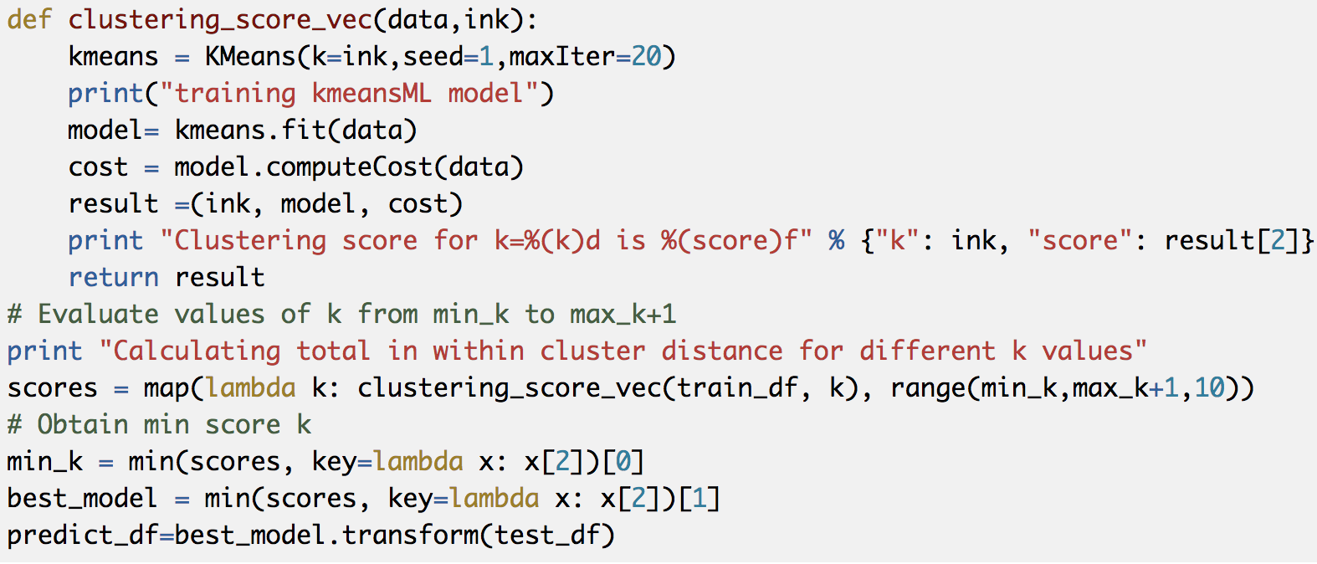
Implementation of Kmeans
Tuning cluster size can be tuned to study the impact on f1

Slide 21
Impact of number of clusters
Increasing the number of clusters from 5 to 20 improves F1. However, after 20 the f1 drops.
As the total number of types of attacks in the dataset is around 23, the number shows that Kmeans
can effectively identifies the patterns of attacks.

Slide 22
Other implementation details
Scripts are developed to simply the model training and testing process
The implementation allows users to separate the training and testing phase so that the learned models can be used to predict different datasets

Slide 23
Comparison across three models: F1 and execution time
While DT achieves highest F1 score, the training time and test time is longer than the other two models.
Thus there is a trade off between f1 and the performance.

Slide 24
Summary
I analyzed the datasets to see that smurf and neptune are the top two frequent attacks
I employed three different learning algorithms to train the models and see that while the three algorithms achieve similar F1(around 0.95), the training time and test time is slower for DT as it uses a recursive binary split approach.
The source code is available at:
https://github.com/lm121/kcup
Future work:
It would be interesting to apply deep learning technique and compare F1 and performance with learned models.
Run the data on distributed platforms to study the impact on runtime performance
Compare f1 of original data VS the version after removing duplicates

Slide 25
References
KDD Cup 99 challenge https://github.com/jadianes/kdd-cup-99-spark
Ryza, Sandy. Advanced analytics with spark: patterns for learning from data at scale. " O'Reilly Media, Inc.", 2017.
Jose A Dianes, KDD Cup 99 – PySpark, https://github.com/jadianes/kdd-cup-99-spark

Slide 26
Backup

Slide 27
Basic features: attributes of individual TCP connections
eature name | description | type
duration | length (number of seconds) of the connection | continuous
protocol_type | type of the protocol, e.g. tcp, udp, etc. | discrete
service | network service on the destination, e.g., http, telnet, etc. | discrete
src_bytes | number of data bytes from source to destination | continuous
dst_bytes | number of data bytes from destination to source | continuous
flag | normal or error status of the connection | discrete
land | 1 if connection is from/to the same host/port; 0 otherwise | discrete
wrong_fragment | number of "wrong" fragments | continuous
urgent | number of urgent packets | continuous

Slide 28
Content features
feature name | description | type
hot | number of "hot" indicators | continuous
num_failed_logins | number of failed login attempts | continuous
logged_in | 1 if successfully logged in; 0 otherwise | discrete
num_compromised | number of "compromised" conditions | continuous
root_shell | 1 if root shell is obtained; 0 otherwise | discrete
su_attempted | 1 if "su root" command attempted; 0 otherwise | discrete
num_root | number of "root" accesses | continuous
num_file_creations | number of file creation operations | continuous
num_shells | number of shell prompts | continuous
num_access_files | number of operations on access control files | continuous
num_outbound_cmds | number of outbound commands in an ftp session | continuous
is_hot_login | 1 if the login belongs to the "hot" list; 0 otherwise | discrete
is_guest_login | 1 if the login is a &qquot;guest"login; 0 otherwise | discrete

Slide 29
Traffic Features
feature name | description> | type
count | number of connections to the same host as the current connection in the past two seconds | continuous
Note: The following features refer to these same-host connections.
serror_rate | % of connections that have "SYN" errors | continuous
rerror_rate | % of connections that have "REJ" errors | continuous
same_srv_rate | % of connections to the same service | continuous
diff_srv_rate | % of connections to different services | continuous
srv_count | number of connections to the same service as the current connection in the past two seconds | continuous
Note: The following features refer to these same-service connections.
srv_serror_rate | % of connections that have "SYN" errors | continuous
srv_rerror_rate | % of connections that have "REJ" errors | continuous
srv_diff_host_rate | % of connections to different hosts | continuous

Slide 30
Four different types of attack
 | description | Attack types
DOS | Deny of service | Back,Neptune, pod, land, teardrop, smurf
R2L | Unauthorized access from a remote machine | ftp_write, guess_passwd, multihop, perl,phf, spy, warezclient, warezmaster
U2R | Unauthorized access to local super user privileges | buffer_overflow, loadmodule, rootkit
Probe | Surveillance and other probing | Ipsweep, portsweep , nmap, satan

